Slide 1
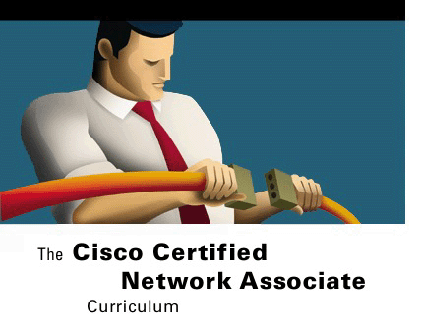



ETHERNET SWITCHING
Networking Basics
Version 3.0
Cisco Regional Networking Academy
mailto: info@saigonctt.com

Slide 2
Objectives
Define bridging and switching
Define collisions, broadcasts, collision domains, and broadcast domains.
Identify the Layer 1, 2, and 3 devices used to create collision domains and broadcast domains.

Slide 3
Table of Content
1 | Ethernet switching
2 | Collision domain and Broadcast domain.

Slide 4

Ethernet Switching

Slide 5


Layer 2 bridging
00000CAAAAAA
00000CAAAAAA | 00000CDDDDD
00000CBBBBBB
A
B
MAC Address | Port
00000CAAAAAA | 1
00000CBBBBBB | 1
00000CCCCCCC | 2
00000CDDDDDD | 2
1
2
00000CCCCCCC
00000CDDDDDD
C
D
Notes:
Layer 2 bridging
As more nodes are added to an Ethernet physical segment, contention for the media increases. Ethernet is a shared media, which means only one node can transmit data at a time. The addition of more nodes increases the demands on the available bandwidth and places additional loads on the media. By increasing the number of nodes on a single segment, the probability of collisions increases, resulting in more retransmissions. A solution to the problem is to break the large segment into parts and separate it into isolated collision domains. To accomplish this a bridge keeps a table of MAC addresses and the associated ports. The bridge then forwards or discards frames based on the table entries. The following steps illustrate the operation of a bridge:
The bridge has just been started so the bridge table is empty. The bridge just waits for traffic on the segment. When traffic is detected, it is processed by the bridge.
Host A is pinging Host B. Since the data is transmitted on the entire collision domain segment, both the bridge and Host B process the packet.
The bridge adds the source address of the frame to its bridge table. Since the address was in the source address field and the frame was received on port 1, the frame must be associated with port 1 in the table.
The destination address of the frame is checked against the bridge table. Since the address is not in the table, even though it is on the same collision domain, the frame is forwarded to the other segment. The address of Host B has not been recorded yet as only the source address of a frame is recorded.
Host B processes the ping request and transmits a ping reply back to Host A. The data is transmitted over the whole collision domain. Both Host A and the bridge receive the frame and process it.
The bridge adds the source address of the frame to its bridge table. Since the source address was not in the bridge table and was received on port 1, the source address of the frame must be associated with port 1in the table. The destination address of the frame is checked against the bridge table to see if its entry is there. Since the address is in the table, the port assignment is checked. The address of Host A is associated with the port the frame came in on, so the frame is not forwarded.
Host A is now going to ping Host C. Since the data is transmitted on the entire collision domain segment, both the bridge and Host B process the frame. Host B discards the frame as it was not the intended destination.
The bridge adds the source address of the frame to its bridge table. Since the address is already entered into the bridge table the entry is just renewed.
The destination address of the frame is checked against the bridge table to see if its entry is there. Since the address is not in the table, the frame is forwarded to the other segment. The address of Host C has not been recorded yet as only the source address of a frame is recorded.
Host C processes the ping request and transmits a ping reply back to Host A. The data is transmitted over the whole collision domain. Both Host D and the bridge receive the frame and process it. Host D discards the frame, as it was not the intended destination.
The bridge adds the source address of the frame to its bridge table. Since the address was in the source address field and the frame was received on port 2, the frame must be associated with port 2 in the table.
The destination address of the frame is checked against the bridge table to see if its entry is present. The address is in the table but it is associated with port 1, so the frame is forwarded to the other segment.
When Host D transmits data, its MAC address will also be recorded in the bridge table. This is how the bridge controls traffic between to collision domains.
These are the steps that a bridge uses to forward and discard frames that are received on any of its ports.

Slide 6
Switch operation
A multi port bridge.
Micro-segment
Support full duplex.
Hardware switching.
Dynamically builds and maintains a Content-Addressable Memory (CAM) table.
Notes:
When only one node is connected to a switch port, the collision domain on the shared media contains only two nodes. The two nodes in this small segment, or collision domain, consist of the switch port and the host connected to it. These small physical segments are called microsegments.
In a network that uses twisted-pair cabling, one pair is used to carry the transmitted signal from one node to the other node. A separate pair is used for the return or received signal. It is possible for signals to pass through both pairs simultaneously. The capability of communication in both directions at once is known as full duplex. The bandwidth is doubled when using full duplex.
Content-addressable memory (CAM) is memory that essentially works backwards compared to conventional memory. Entering data into the memory will return the associated address. Using CAM allows a switch to directly find the port that is associated with a MAC address without using search algorithms. An application-specific integrated circuit (ASIC) is a device consisting of undedicated logic gates that can be programmed to perform functions at logic speeds. Operations that might have been done in software can now be done in hardware using an ASIC. The use of these technologies greatly reduced the delays caused by software processing

Slide 7
Latency
Media delays caused by the finite speed that signals can travel through the physical media.
Circuit delays caused by the electronics that process the signal along the path.
Software delays caused by the decisions that software must make to implement switching and protocols.
Delays caused by the content of the frame and where in the frame switching decisions can be made.
Notes:
Latency is the delay between the time a frame first starts to leave the source device and the time the first part of the frame reaches its destination. A wide variety of conditions can cause delays as a frame travels from source to destination:
Media delays caused by the finite speed that signals can travel through the physical media.
Circuit delays caused by the electronics that process the signal along the path.
Software delays caused by the decisions that software must make to implement switching and protocols.
Delays caused by the content of the frame and where in the frame switching decisions can be made. For example, a device cannot route a frame to a destination until the destination MAC address has been read.

Slide 8
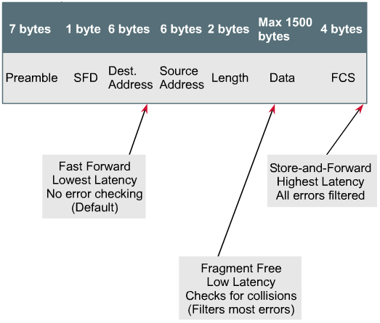
Switch modes
Notes:
When using cut-through methods of switching, both the source port and destination port must be operating at the same bit rate in order to keep the frame intact. This is called synchronous switching. If the bit rates are not the same, the frame must be stored at one bit rate before it is sent out at the other bit rate. This is known as asynchronous switching. Store-and-forward mode must be used for asynchronous switching

Slide 9
Switch modes
Store-and-forward:
  The entire frame is received before forward.
  The latency is greater with larger frames.
  Error detection is high.
  Must be used for asynchronous switching.
Cut-through:
  The switch reads the destination address before receiving the entire frame.
  The frame is then forwarded before the entire frame arrives.
  Fast-forward and Fragment-free switching.
Notes:
How a frame is switched to the destination port is a trade off between latency and reliability. A switch can start to transfer the frame as soon as the destination MAC address is received. Switching at this point is called cut-through switching and results in the lowest latency through the switch. However, no error checking is available. At the other extreme, the switch can receive the entire frame before sending it out the destination port. This gives the switch software an opportunity to verify the Frame Check Sum (FCS) to ensure that the frame was reliably received before sending it to the destination. If the frame is found to be invalid, it is discarded at this switch rather than at the ultimate destination. Since the entire frame is stored before being forwarded, this mode is called store-and-forward. A compromise between the cut-through and store-and-forward modes is the fragment-free mode. Fragment-free reads the first 64 bytes, which includes the frame header, and switching begins before the entire data field and checksum are read. This mode verifies the reliability of the addressing and Logical Link Control (LLC) protocol information to ensure the destination and handling of the data will be correct.
When using cut-through methods of switching, both the source port and destination port must be operating at the same bit rate in order to keep the frame intact. This is called synchronous switching. If the bit rates are not the same, the frame must be stored at one bit rate before it is sent out at the other bit rate. This is known as asynchronous switching. Store-and-forward mode must be used for asynchronous switching.
Asymmetric switching provides switched connections between ports of unlike bandwidths, such as a combination of 100 Mbps and 1000 Mbps. Asymmetric switching is optimized for client/server traffic flows in which multiple clients simultaneously communicate with a server, requiring more bandwidth dedicated to the server port to prevent a bottleneck at that port.

Slide 10
Spanning-Tree Protocol
Frame Loop
Notes:
When multiple switches are arranged in a simple hierarchical tree, switching loops are unlikely to occur. However, switched networks are often designed with redundant paths to provide for reliability and fault tolerance. While redundant paths are desirable, they can have undesirable side effects. Switching loops are one such side effect. Switching loops can occur by design or by accident, and they can lead to broadcast storms that will rapidly overwhelm a network. To counteract the possibility of loops, switches are provided with a standards-based protocol called the Spanning-Tree Protocol (STP). Each switch in a LAN using STP sends special messages called Bridge Protocol Data Units (BPDUs) out all its ports to let other switches know of its existence and to elect a root bridge for the network. The switches then use the Spanning-Tree Algorithm (STA) to resolve and shut down the redundant paths.
Each port on a switch using Spanning-Tree Protocol exists in one of the following five states:
Blocking
Listening
Learning
Forwarding
Disabled
A port moves through these five states as follows:
From initialization to blocking
From blocking to listening or to disabled
From listening to learning or to disabled
From learning to forwarding or to disabled
From forwarding to disabled
The result of resolving and eliminating loops using STP is to create a logical hierarchical tree with no loops. However, the alternate paths are still available should they be needed.

Slide 11

THE SPANNING TREE PROTOCOL

Slide 12
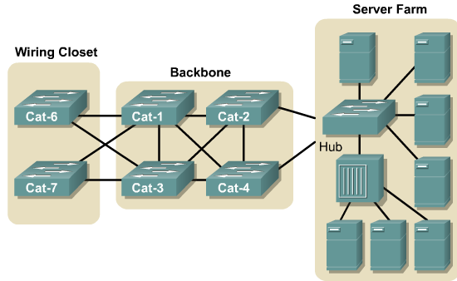
Frame Loop
Notes:
When multiple switches are arranged in a simple hierarchical tree, switching loops are unlikely to occur. However, switched networks are often designed with redundant paths to provide for reliability and fault tolerance. While redundant paths are desirable, they can have undesirable side effects. Switching loops are one such side effect. Switching loops can occur by design or by accident, and they can lead to broadcast storms that will rapidly overwhelm a network. To counteract the possibility of loops, switches are provided with a standards-based protocol called the Spanning-Tree Protocol (STP). Each switch in a LAN using STP sends special messages called Bridge Protocol Data Units (BPDUs) out all its ports to let other switches know of its existence and to elect a root bridge for the network. The switches then use the Spanning-Tree Algorithm (STA) to resolve and shut down the redundant paths.

Slide 13
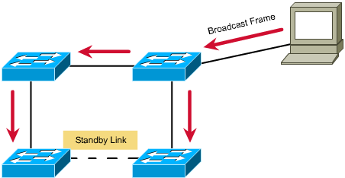
Spanning Tree Protocol (802.1d)
Enables redundant link b/w switches without loops
Spanning Tree Algorithm is implemented by STP to calculate the best loop-free path between switches
Spanning tree frames, BPDU, are exchanged b/w switches to determine spanning-tree topology
Redundant links are in standby mode, which may be activated in case of a topology change
Notes:
To counteract the possibility of loops, switches are provided with a standards-based protocol called the Spanning-Tree Protocol (STP). Each switch in a LAN using STP sends special messages called Bridge Protocol Data Units (BPDUs) out all its ports to let other switches know of its existence and to elect a root bridge for the network. The switches then use the Spanning-Tree Algorithm (STA) to resolve and shut down the redundant paths.

Slide 14
STP port status
Blocking: no frames forwarded, BPDUs heard
Listening: no frames forwarded, listening for frames
Learning: no frames forwarded, learning addresses
Forwarding: frames forwarded, learning addresses
Disabled: no frames forwarded, no BPDUs heard
Boot-up
initialisation
Blocking
state
Listening
state
Disabled
state
Learning
state
Forwarding
state
Notes:
Each port on a switch using Spanning-Tree Protocol exists in one of the following five states:
Blocking
Listening
Learning
Forwarding
Disabled
A port moves through these five states as follows:
From initialization to blocking
From blocking to listening or to disabled
From listening to learning or to disabled
From learning to forwarding or to disabled
From forwarding to disabled
The result of resolving and eliminating loops using STP is to create a logical hierarchical tree with no loops. However, the alternate paths are still available should they be needed.

Slide 15
Collision Domains and Broadcast Domains

Slide 16
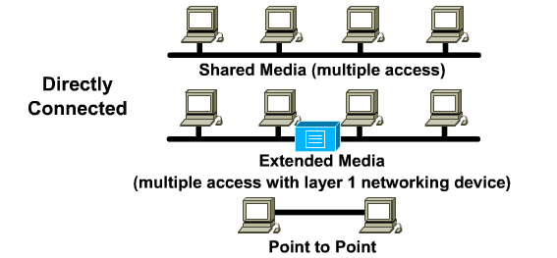
Shared media environments
Shared media environment
Notes:
Understanding collision domains requires understanding what collisions are and how they are caused. To help explain collisions, Layer 1 media and topologies are reviewed here. Some networks are directly connected and all hosts share Layer 1. Examples are listed in the following:
Shared media environment – Occurs when multiple hosts have access to the same medium. For example, if several PCs are attached to the same physical wire, optical fiber, or share the same airspace, they all share the same media environment.
Extended shared media environment – Is a special type of shared media environment in which networking devices can extend the environment so that it can accommodate multiple access or longer cable distances.

Slide 17
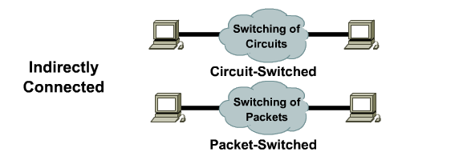
Shared media environments
Packet switching vs. Circuit switching
Notes:
Point-to-point network environment – Is widely used in dialup network connections and is the most familiar to the home user. It is a shared networking environment in which one device is connected to only one other device, such as connecting a computer to an Internet service provider by modem and a phone line.
It is important to be able to identify a shared media environment, because collisions only occur in a shared environment. A highway system is an example of a shared environment in which collisions can occur because multiple vehicles are using the same roads. As more vehicles enter the system, collisions become more likely. A shared data network is much like a highway. Rules exist to determine who has access to the network medium, but sometimes the rules simply cannot handle the traffic load and collisions occur.

Slide 18
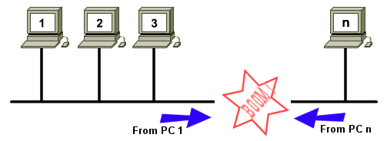
Collisions
More than one node attempts to transmit at the same time.
Collisions occur in broadcast topology:
  Ethernet LAN technology.

Slide 19
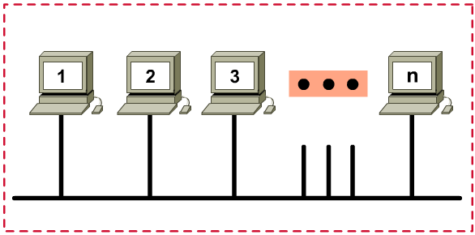
Collisions domain: Share access
Limits the number of computers

Slide 20
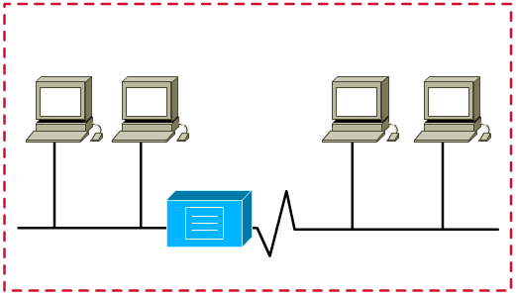
Collisions domain: Repeater
Propagate collisions

Slide 21
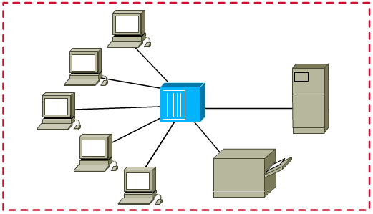
Collisions domain: HUB
Propagate collisions

Slide 22
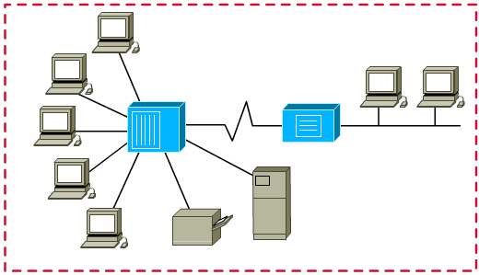
Collisions domain
Collision Domains are the area where collisions occur.
All of layer 1 interconnections are part of the collision domain.
Extending a network with a repeater or a hub, results in a larger collision domain.

Slide 23
4 repeater rule
Ethernet technology.
No more than 4 repeaters or hubs can be between any two computers on collision domain.
Maximum round trip time:
  Max RTT = 512 bit time = 51.2μs.
Max RTT = wait for next transmission.

Slide 24
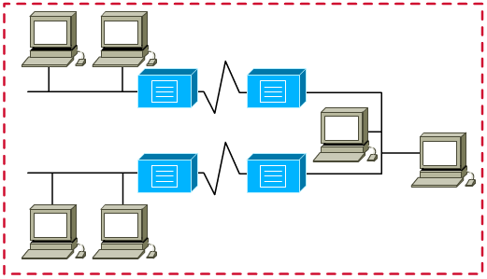
4 repeater rule
5.4.3.2.1 Rule

Slide 25
5-4-3-2-1 rule
5 sections of the network.
4 repeaters or hubs.
3 sections of the network are "mixing" sections (with hosts).
2 sections are link sections (for link purposes).
1 large collision domain.

Slide 26
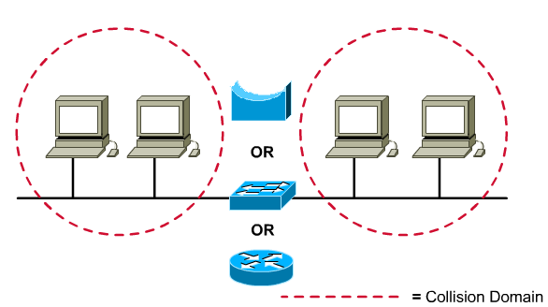
Segmenting Collision Domain
Notes:
Connecting several computers to a single shared-access medium that has no other networking devices attached creates a collision domain. This situation limits the number of computers that can use the medium, also called a segment. Layer 1 devices extend but do not control collision domains.
Layer 2 devices, bridges, and switches, keep track of the MAC addresses and which segment they are on. By doing this these devices can control the flow of traffic at the Layer 2 level.
Layer 3 devices perform more functions than just breaking up a collision domain. Layer 3 devices and their functions will be covered in more depth in the section on broadcast domains.

Slide 27
Layer 2 broadcasts
Number of hosts | Average percentage of CPU lost per host
100 | .14
1000 | .96
10000 | 9.15
0xFFFFFFFFFFFF
Notes:
When a node needs to communicate with all hosts on the network, it sends a broadcast frame with a destination MAC address 0xFFFFFFFFFFFF
Because the NIC must interrupt the CPU to process each broadcast or multicast group it belongs to, broadcast radiation affects the performance of hosts in the network.
Workstations broadcast an Address Resolution Protocol (ARP) request every time they need to locate a MAC address that is not in the ARP table.
As an example, the command telnet mumble.com translates into an IP address through a Domain Name System (DNS) search. To locate the corresponding MAC address an ARP request is broadcast. Generally, IP workstations cache 10 to 100 addresses in their ARP tables for about two hours. The ARP rate for a typical workstation might be about 50 addresses every two hours or 0.007 ARPs per second. Thus, 2000 IP end stations produce about 14 ARPs per second.
Every 30 seconds, RIPv1 uses broadcasts to retransmit the entire RIP routing table to other RIP routers. If 2000 workstations were configured to run RIP and, on average, 50 packets were required to transmit the routing table, the workstations would generate 3333 broadcasts per second. Most network administrators only configure a small number of routers, usually five to ten, to run RIP. For a routing table that has a size of 50 packets, 10 RIP routers would generate about 16 broadcasts per second.
A particular packet video application can generate a seven megabyte (MB) stream of multicast data that, in a switched network, would be sent to every segment, resulting in severe congestion.

Slide 28
Broadcast domains
Notes:
A broadcast domain is a grouping of collision domains that are connected by Layer 2 devices
Broadcast domains are controlled at Layer 3 because routers do not forward broadcasts.

Slide 29
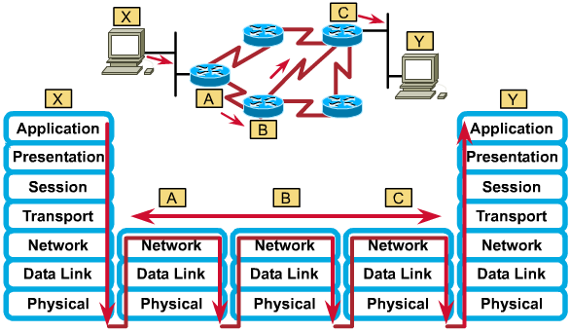
Data flow through a Network
Notes:
Data flow in the context of collision and broadcast domains focuses on how data frames propagate through a network. It refers to the movement of data through Layer 1, 2 and 3 devices and how data must be encapsulated to effectively make that journey. Remember that data is encapsulated at the network layer with an IP source and destination address, and at the data-link layer with a MAC source and destination address.
A good rule to follow is that a Layer 1 device always forwards the frame, while a Layer 2 device wants to forward the frame. In other words, a Layer 2 device will forward the frame unless something prevents it from doing so. A Layer 3 device will not forward the frame unless it has to. Using this rule will help identify how data flows through a network.
Layer 1 devices do no filtering, so everything that is received is passed on to the next segment. The frame is simply regenerated and retimed and thus returned to its original transmission quality. Any segments connected by Layer 1 devices are part of the same domain, both collision and broadcast.
Layer 2 devices filter data frames based on the destination MAC address. A frame is forwarded if it is going to an unknown destination outside the collision domain. The frame will also be forwarded if it is a broadcast, multicast, or a unicast going outside of the local collision domain. The only time that a frame is not forwarded is when the Layer 2 device finds that the sending host and the receiving host are in the same collision domain. A Layer 2 device, such as a bridge, creates multiple collision domains but maintains only one broadcast domain.
Layer 3 devices filter data packets based on IP destination address. The only way that a packet will be forwarded is if its destination IP address is outside of the broadcast domain and the router has an identified location to send the packet. A Layer 3 device creates multiple collision and broadcast domains.
Data flow through a routed IP based network, involves data moving across traffic management devices at Layers 1, 2, and 3 of the OSI model. Layer 1 is used for transmission across the physical media, Layer 2 for collision domain management, and Layer 3 for broadcast domain management.

Slide 30
What is a network segment?
Data stream from session layer
Segment
Segment
Segment
Data stream segments
Two network segments
Wire segment
Notes:
Section of a network that is bounded by bridges, routers, or switches.
In a LAN using a bus topology, a segment is a continuous electrical circuit that is often connected to other such segments with repeaters.
Term used in the TCP specification to describe a single transport layer unit of information. The terms datagram, frame, message, and packet are also used to describe logical information groupings at various layers of the OSI reference model and in various technology circles.
To properly define the term segment, the context of the usage must be presented with the word. If segment is used in the context of TCP, it would be defined as a separate piece of the data. If segment is being used in the context of physical networking media in a routed network, it would be seen as one of the parts or sections of the total network.

Slide 31

Summary
Bridging and switching evolution
Store-and-forward and cut-through switching modes
Spanning-Tree Protocol (STP)
Collisions, broadcasts, collision domains, and broadcast domains
The Layer 1, 2, and 3 devices used to create collision domains and broadcast domains
Data flow and problems with broadcasts

Slide 32

Q&A
Notes:
_________________________________________________________________________
_________________________________________________________________________
_________________________________________________________________________
_________________________________________________________________________
_________________________________________________________________________
_________________________________________________________________________
_________________________________________________________________________
_________________________________________________________________________
_________________________________________________________________________
_________________________________________________________________________
_________________________________________________________________________
_________________________________________________________________________
_________________________________________________________________________
_________________________________________________________________________
_________________________________________________________________________
_________________________________________________________________________
_________________________________________________________________________
_________________________________________________________________________
_________________________________________________________________________

Slide 33
Enjoy the Course
Notes:
_________________________________________________________________________
_________________________________________________________________________
_________________________________________________________________________
_________________________________________________________________________
_________________________________________________________________________
_________________________________________________________________________
_________________________________________________________________________
_________________________________________________________________________
_________________________________________________________________________
_________________________________________________________________________
_________________________________________________________________________
_________________________________________________________________________
_________________________________________________________________________
_________________________________________________________________________
_________________________________________________________________________
_________________________________________________________________________
_________________________________________________________________________
_________________________________________________________________________
_________________________________________________________________________

